Slide 1
4.2 Other norms for finite-dimensional vectors

Slide 2
Introduction
In this topic, we will
Define the 1-norm and the infinity-norm for finite-dimensional vectors R^{n} and C^{n}
Observe they continue to satisfy the properties of a norm
Explain their application

Slide 3
Norms of vectors
If , we will define
The 1-norm
The ∞-norm

Slide 4
Norms of vectors
Thus, if , then

Slide 5
Norms of vectors
Both of these also satisfy the three properties:
and if and only if u = 0

Slide 6
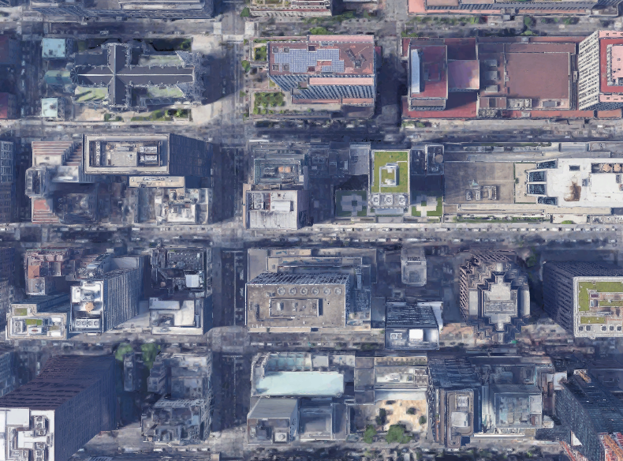
Norms of vectors
Why would an engineer use a different norm?
Usually, engineers use the 2-norm
However, what if you’re a tourist in New York
Is the distance 267 m or 382 m? That is,

Slide 7
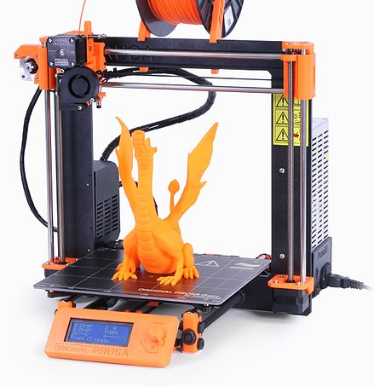
Norms of vectors
Why would an engineer use a different norm?
Consider moving the head of a 3-d printer
The time it takes to get from u to v depends on
Josef Prusa

Slide 8
Norms of vectors
In this course,
we will almost exclusively use the 2-norm
However, there are scenarios where engineers will use other, and more suitable, norms

Slide 9
Summary
Following this topic, you now
Are aware of the 1- and infinity-norms
Understand they have properties similar to the 2-norm
Are aware that there are applications of other norms

Slide 10
References
[1] https://en.wikipedia.org/wiki/Norm_(mathematics)

Slide 11
Acknowledgments
None so far.

Slide 12
Colophon
These slides were prepared using the Cambria typeface. Mathematical equations use Times New Roman, and source code is presented using Consolas.
The photographs of flowers and a monarch butter appearing on the title slide and accenting the top of each other slide were taken at the Royal Botanical Gardens in October of 2017 by Douglas Wilhelm Harder. Please see
https://www.rbg.ca/
for more information.

Slide 13
Disclaimer
These slides are provided for the ne 112 Linear algebra for nanotechnology engineering course taught at the University of Waterloo. The material in it reflects the authors’ best judgment in light of the information available to them at the time of preparation. Any reliance on these course slides by any party for any other purpose are the responsibility of such parties. The authors accept no responsibility for damages, if any, suffered by any party as a result of decisions made or actions based on these course slides for any other purpose than that for which it was intended.

